Slide 1

Capstone project
Week 1
By inori

Slide 2

INTRODUCTION
Project:
A friend need recommendation for a location to live
North York or Markham in Toronto
She loves eating especially Japanese food and does not like walking
So Priority is restaurant nearby with high rating and good review
Have schools nearby
.

Slide 3
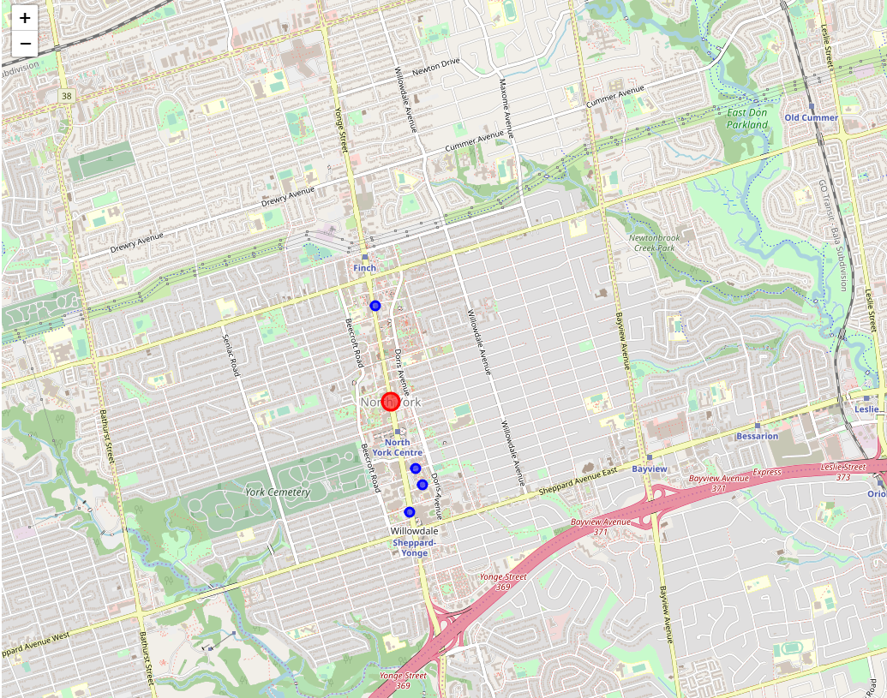
DATA section North York
Generate the map

Slide 4
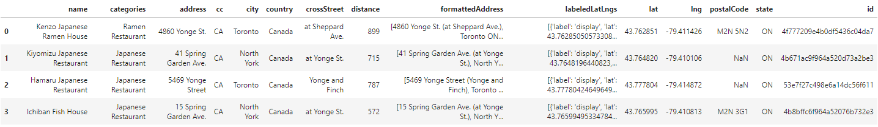
DATA section
4 restaurants in 1000m
The closest one would be Ichiban Fish House

Slide 5
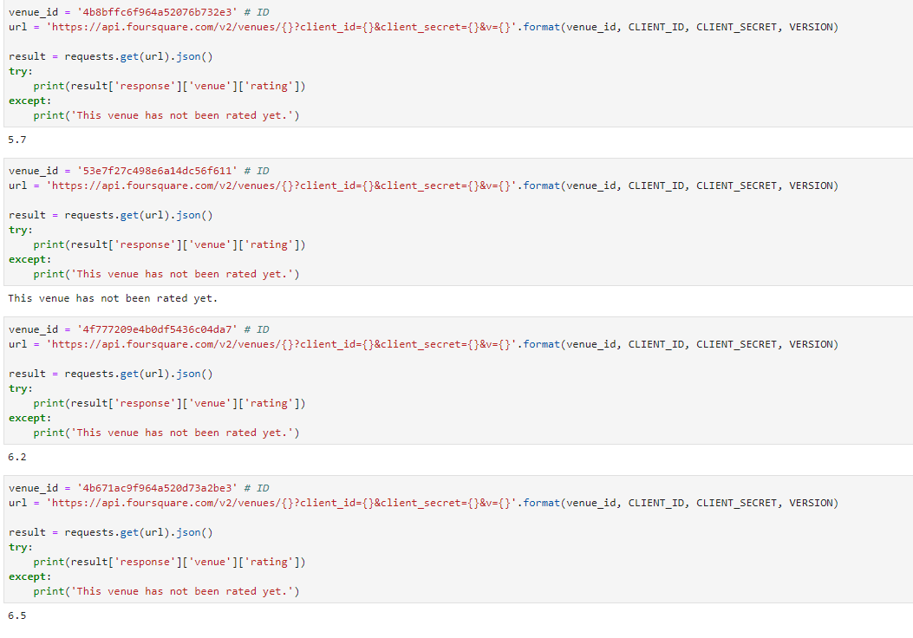
DATA section
Restaurants’ rating

Slide 6
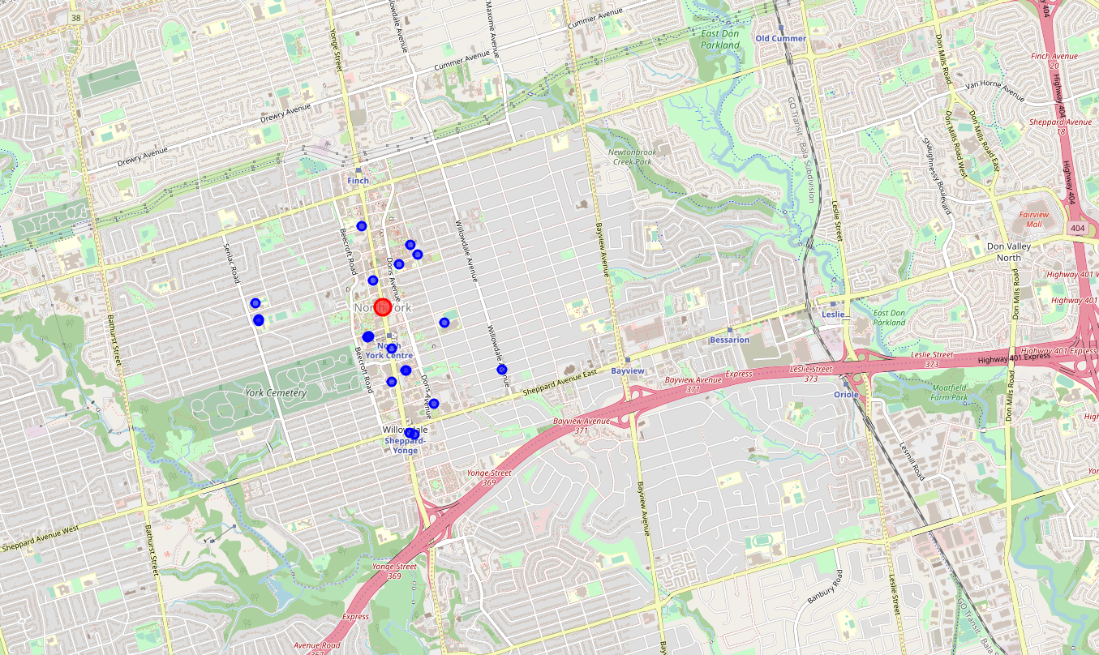
DATA section
Schools nearby

Slide 7
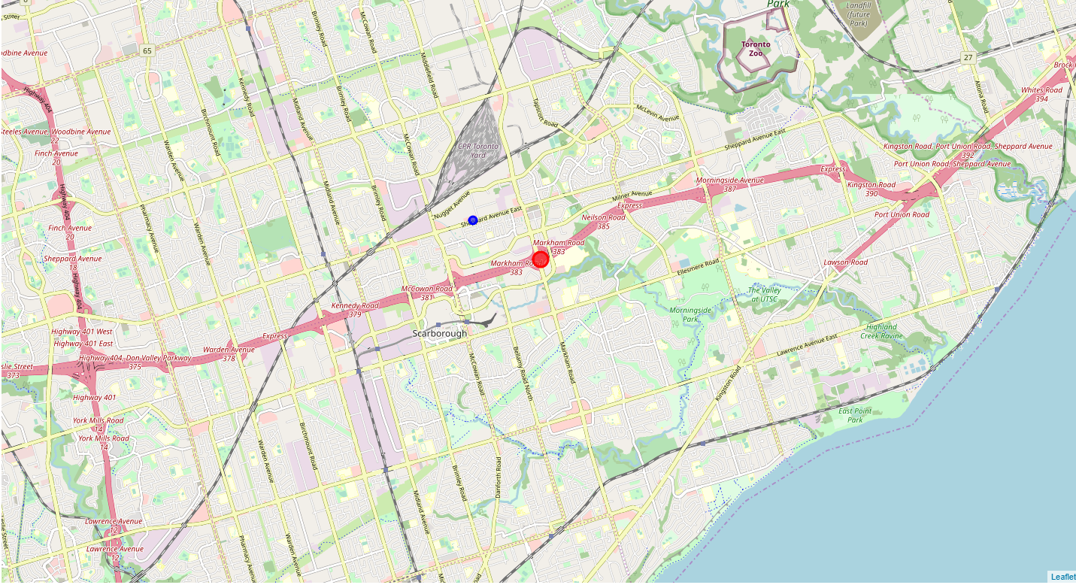
DATA section Markham
Generate the map

Slide 8
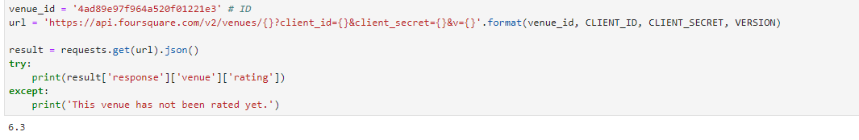
DATA section
Restaurant rating

Slide 9
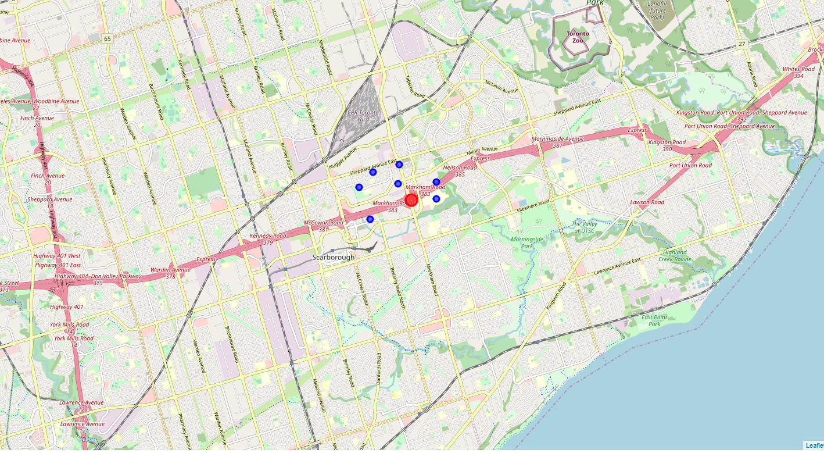
DATA section
Schools nearby

Slide 10

CONCLUSION
Compare with these two areas
North York has 4 Japanese restaurants and markham has only 1 restaurant within 1000m
4 restaurants’ rating are fine
And North York has more schools nearby
So I would recommend to live in North York area

Slide 11
Thank You !
Inori

